Slide 1

The Fourth Hour!
Welcome to…

Slide 2
Introduction
Welcome to the Fourth Hour!
Name
Professor
A fun fact about you

Slide 3
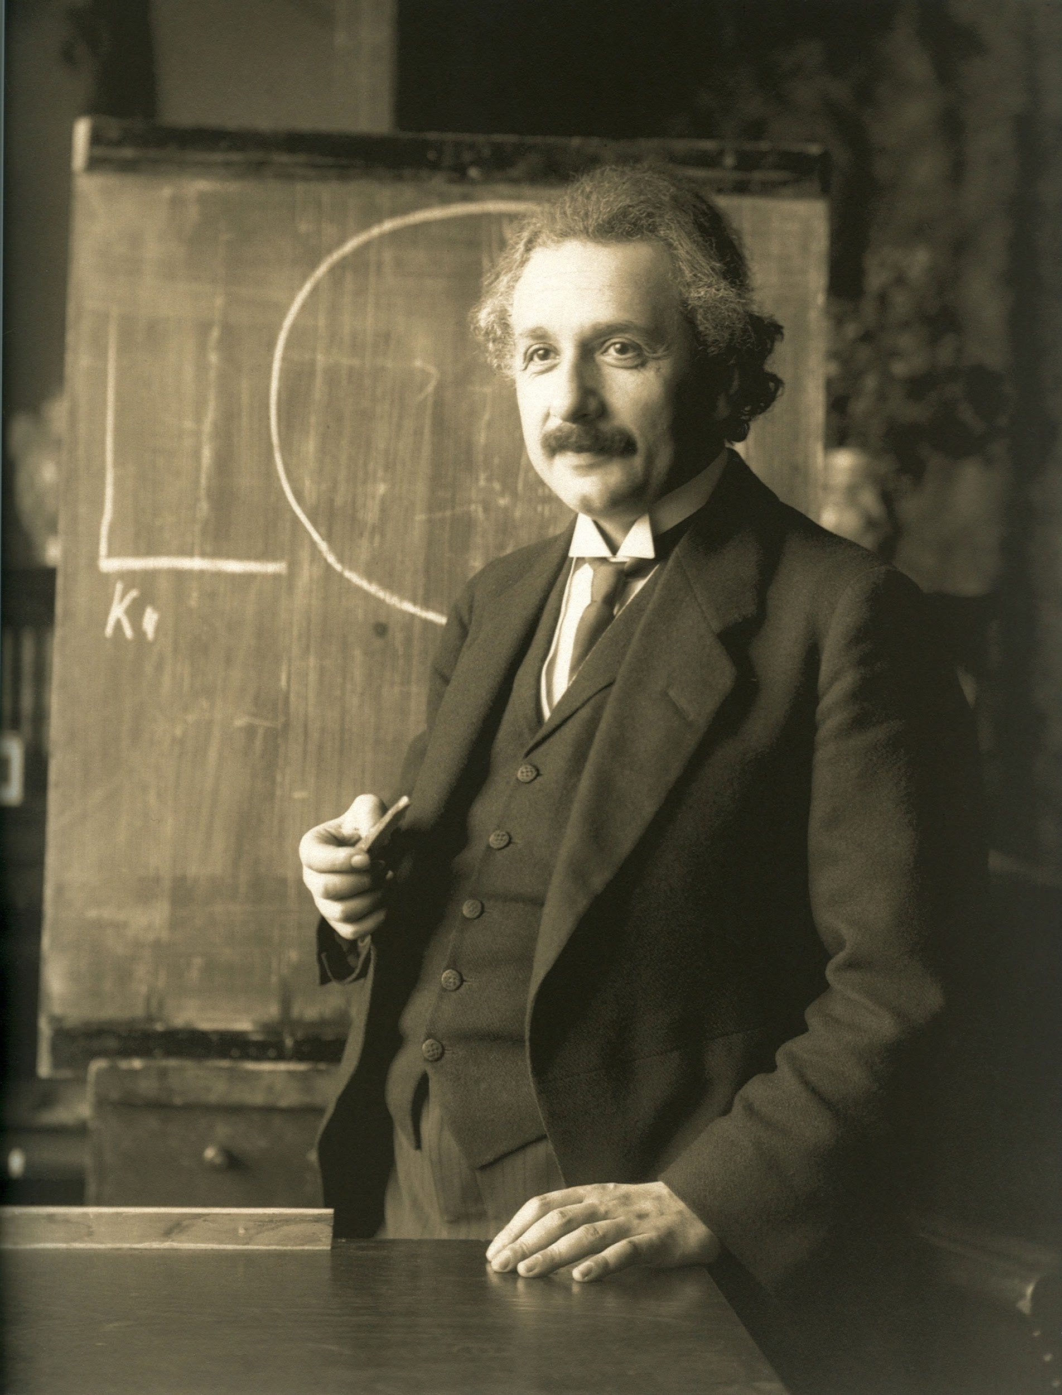
“Anyone who has never made a mistake has never tried anything new.”

Slide 4
The String Data Type
Text in programs is represented by Strings
It is a sequence of characters in between “ ”
For example:
“Hey everyone!”
“4”

Slide 5
String From User Input
How do we get a String from the user?

Slide 6
String From User Input
How do we get a String from the user?
name = input(“What is your name?”)
print(“Name:”, name)
Notes:
A TON of students dont understand this

Slide 7
String From User Input
How do we get a String from the user?
name = input(“What is your name?”)
print(“Name:”, name)
What is your name? Reese
Name: Reese
We now have the String “Reese” stored in the variable name
Notes:
A TON of students dont understand this

Slide 8
Manipulating User Input
Let’s continue with name = “Reece”
How would we get just the first letter?

Slide 9
Manipulating User Input
Let’s continue with name = “Reece”
How would we get just the first letter?
print(name[0])
What about just the last letter?

Slide 10
Manipulating User Input
Let’s continue with name = “Reece”
How would we get just the first letter?
print(name[0])
What about just the last letter?
print(name[-1])
In Python we can use negative indices to go backwards through a String
Notes:
How else might we get last letter? name[len(name-1)]

Slide 11
Review
Login to Socrative at https://b.socrative.com/login/student/
Use code 4thHour149

Slide 12
Question 1
What does the following code print?
phrase = “CS Rocks!”
print(phrase[1])
‘C’
‘S’
‘!’
‘s’

Slide 13
Question 1
What does the following code print?
phrase = “CS Rocks!”
print(phrase[1])
‘C’
‘S’
‘!’
‘s’
Notes:
Remember index start at 0

Slide 14
Manipulating User Input
Each letter of the String “Reese” can be represented in more than one way.
0
1
2
3
4
Reese
-5
-4
-3
-2
-1
Notice how the first letter has an index of 0 and the last one is the length of the String - 1

Slide 15
Question 2 - PI
What does the following code print?
phrase = “CS Rocks!”
print(phrase[len(phrase)])
‘C’
‘s’
‘!’
ERROR
Notes:
Out of bounds.

Slide 16
Question 2 - PI
What does the following code print?
phrase = “CS Rocks!”
print(phrase[len(phrase)])
‘C’
‘s’
‘!’
ERROR

Slide 17
Lists
A comma separated list of items enclosed by square brackets is a list
Lists can store any type in Python for example:
nums = [1, 2, 3, 4, 5, 6, 7]
nums2 = [1, 2, “three”, 4, 5, “six”, 7]
classes = [“CS 149”, “CS 101”, “HTH 100”, “MATH 220”]
double_list = [1, 2, 3, [4 , 5]]

Slide 18
List Operations
lst1 = [1, 2, 3] lst2 = [4, 5, 6]
lst1 + lst2 = ?

Slide 19
List Operations
lst1 = [1, 2, 3] lst2 = [4, 5, 6]
lst1 + lst2 = [1, 2, 3, 4, 5, 6]
len(lst1) = ?

Slide 20
List Operations
lst1 = [1, 2, 3] lst2 = [4, 5, 6]
lst1 + lst2 = [1, 2, 3, 4, 5, 6]
len(lst1) = 3
min(lst2) = ?

Slide 21
List Operations
lst1 = [1, 2, 3] lst2 = [4, 5, 6]
lst1 + lst2 = [1, 2, 3, 4, 5, 6]
len(lst1) = 3
min(lst2) = 4
sum(lst1 + lst2) = ?

Slide 22
List Operations
lst1 = [1, 2, 3] lst2 = [4, 5, 6]
lst1 + lst2 = [1, 2, 3, 4, 5, 6]
len(lst1) = 3
min(lst2) = 4
sum(lst1 + lst2) = 21
lst1*3 = ?

Slide 23
List Operations
lst1 = [1, 2, 3] lst2 = [4, 5, 6]
lst1 + lst2 = [1, 2, 3, 4, 5, 6]
len(lst1) = 3
min(lst2) = 4
sum(lst1 + lst2) = 21
lst1*3 = [1, 2, 3, 1, 2, 3, 1, 2, 3]

Slide 24
Question 3 - PI
What does the following code print?
q2 = [5]
print(q2*3)
[15]
[5, 5, 5]
15
ERROR

Slide 25
Question 3 - PI
What does the following code print?
q2 = [5]
print(q2*3)
[15]
[5, 5, 5]
15
ERROR

Slide 26
Modifying Lists
lst1 = [1, 2, 3]
What does our list look like after…
lst1[0] = “mouse” → ?

Slide 27
Modifying Lists
lst1 = [1, 2, 3]
What does our list look like after…
lst1[0] = “mouse” → [‘mouse’, 2, 3]
lst1[-1] = [3, 4] → ?

Slide 28
Modifying Lists
lst1 = [1, 2, 3]
What does our list look like after…
lst1[0] = “mouse” → [‘mouse’, 2, 3]
lst1[-1] = [3, 4] → [‘mouse’, 2, [3, 4]]
lst1[len(lst1) - 2] = 7 → ?

Slide 29
Modifying Lists
lst1 = [1, 2, 3]
What does our list look like after…
lst1[0] = “mouse” → [‘mouse’, 2, 3]
lst1[-1] = [3, 4] → [‘mouse’, 2, [3, 4]]
lst1[len(lst1) - 2] = 7 → [‘mouse’, 7, [3, 4]]

Slide 30
The Split() Method
The split method will split a String into a list based off the given parameter
For example:
“1,2,3,4”.split(“,”) →[‘1’, ‘2’, ‘3’, ‘4’]
“1 2 3 4”.split(“ ”) →[‘1’, ‘2’, ‘3’, ‘4’]
“1 2 3 4”.split() →[‘1’, ‘2’, ‘3’, ‘4’]
When no parameter is specified split will split based of “ “
Notes:
Explain why.split is important and how you cant edit specific parts of a string but you can edit parts of a list

Slide 31
Question 4
What does the following code print?
words = “apple/carrot/banana”.split(‘/’)
print(words)
“apple/carrot/banana”
[‘apple’, ‘carrot’, ‘banana’]
[“apple/carrot/banana”]
ERROR

Slide 32
Question 4
What does the following code print?
words = “apple/carrot/banana”.split(‘/’)
print(words)
“apple/carrot/banana”
[‘apple’, ‘carrot’, ‘banana’]
[“apple/carrot/banana”]
ERROR

Slide 33
Tuples
Tuples and lists are the same except tuples are immutable while lists are mutable.
What does this mean?
Mutable means that a variable can be changed or modified.
Immutable means that a variable cannot be changed

Slide 34
Tuples
Mutable means that a variable can be changed or modified.
Immutable means that a variable cannot be changed
For example:
myTuple = ("apple", "banana", "cherry")
myTuple[0] = "orange"
Gives us an error when we run:
TypeError: 'tuple' object does not support item assignment

Slide 35
Dictionary
Dictionaries are a list of keys and values for example:
dict = {‘name’: 'Reese', ‘age’: '22', ‘major’: ‘CS’}
Notice how the dictionary is declared by listing key: value pairs
What would we do if we wanted to add a Hometown of Richmond to the dictionary above?

Slide 36
Dictionary
Dictionaries are a list of keys and values for example:
dict = {‘name’: 'Reese', ‘age’: '22', ‘major’: ‘CS’}
Notice how the dictionary is declared by listing key: value pairs
What would we do if we wanted to add a Hometown of Richmond to the dictionary above?
dict[‘Hometown’] = Richmond

Slide 37
Dictionary
Dictionaries do not use indices, instead just use the key to get and remove
dict = {'name': 'Reese', 'age': 22, 'major': 'CS'}
print(dict.get(‘name’))
Reese
dict.pop(‘name’)
print(dict)
{'age': 22, 'major': 'CS'}

Slide 38
Set
Essentially a list, but it can not contain duplicates.
For example:
nums = {1, 2, 3}
nums.add(4) → ?

Slide 39
Set
Essentially a list, but it can not contain duplicates.
For example:
nums = {1, 2, 3}
nums.add(4) → {1, 2, 3, 4}
nums.add(4) → ?

Slide 40
Set
Essentially a list, but it can not contain duplicates.
For example:
nums = {1, 2, 3}
nums.add(4) → {1, 2, 3, 4}
nums.add(4) → {1, 2, 3, 4}
nums.remove(4) → ?

Slide 41
Set
Essentially a list, but it can not contain duplicates.
For example:
nums = {1, 2, 3}
nums.add(4) → {1, 2, 3, 4}
nums.add(4) → {1, 2, 3, 4}
nums.remove(4) → {1, 2, 3}

Slide 42
Question 5
What does the following code print?
words = {“apple”, “banana”, “carrot”}
words.add(“banana”)
words.add(1)
{“apple”, “banana”, “carrot”}
{“apple”, “banana”, “carrot”, 1}
{“apple”, “banana”, “carrot”, banana, 1}
ERROR

Slide 43
Question 5
What does the following code print?
words = {“apple”, “banana”, “carrot”}
words.add(“banana”)
words.add(1)
{“apple”, “banana”, “carrot”}
{“apple”, “banana”, “carrot”, 1}
{“apple”, “banana”, “carrot”, banana, 1}
ERROR

Slide 44
Extra time…
a = "blue"
b = "red"
c = "green"
d = b
e = a
f = d
print(a)
print(b)
print(c)
print(d)
print(e)
print(f)
c = f
print(c)
print(f)
What does this print?
Notes:
Draw on board then in Python Tutor

Slide 45
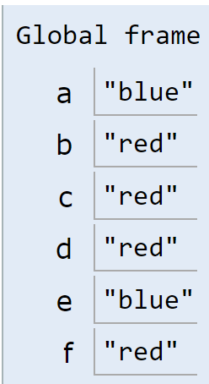
Extra time…
a = "blue"
b = "red"
c = "green"
d = b
e = a
f = d
print(a)
print(b)
print(c)
print(d)
print(e)
print(f)
c = f
print(c)
print(f)
What does this print?
blue
red
green
red
blue
red
red
red

Slide 46
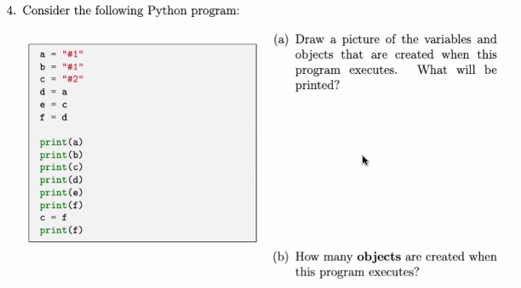
Extra time…

Slide 47
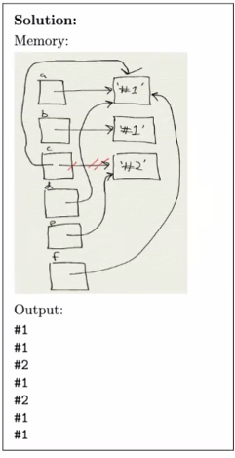
Extra time…

Slide 48
Socrative Slides

Slide 49
Question 1
What does the following code print?
phrase = “CS Rocks!”
print(phrase[1])
‘C’
‘S’
‘!’
‘s’

Slide 50
Question 1
What does the following code print?
phrase = “CS Rocks!”
print(phrase[1])
‘C’
‘S’
‘!’
‘s’

Slide 51
Question 2 - PI
What does the following code print?
phrase = “CS Rocks!”
print(phrase[len(phrase)])
‘C’
‘s’
‘!’
ERROR

Slide 52
Question 2 - PI
What does the following code print?
phrase = “CS Rocks!”
print(phrase[len(phrase)])
‘C’
‘s’
‘!’
ERROR

Slide 53
Question 3 - PI
What does the following code print?
q2 = [5]
print(q2*3)
[15]
[5, 5, 5]
15
ERROR

Slide 54
Question 3 - PI
What does the following code print?
q2 = [5]
print(q2*3)
[15]
[5, 5, 5]
15
ERROR

Slide 55
Question 4
What does the following code print?
words = “apple/carrot/banana”.split(‘/’)
print(words)
“apple/carrot/banana”
[‘apple’, ‘carrot’, ‘banana’]
[“apple/carrot/banana”]
ERROR

Slide 56
Question 4
What does the following code print?
words = “apple/carrot/banana”.split(‘/’)
print(words)
“apple/carrot/banana”
[‘apple’, ‘carrot’, ‘banana’]
[“apple/carrot/banana”]
ERROR

Slide 57
Question 5
What does the following code print?
words = {“apple”, “banana”, “carrot”}
words.add(“banana”)
words.add(1)
{“apple”, “banana”, “carrot”}
{“apple”, “banana”, “carrot”, 1}
{“apple”, “banana”, “carrot”, banana, 1}
ERROR

Slide 58
Question 5
What does the following code print?
words = {“apple”, “banana”, “carrot”}
words.add(“banana”)
words.add(1)
{“apple”, “banana”, “carrot”}
{“apple”, “banana”, “carrot”, 1}
{“apple”, “banana”, “carrot”, banana, 1}
ERROR

